Slide 1

Geospatial Chart Types

Slide 2
Choropleths
Notes:
Decisions about encodings for mapping your data

Slide 3
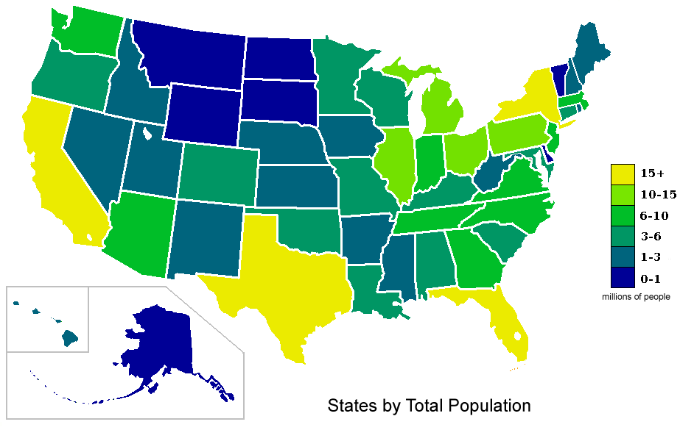
http://upload.wikimedia.org/wikipedia/commons/4/48/USA_states_population_map_2007_color.png

Slide 4
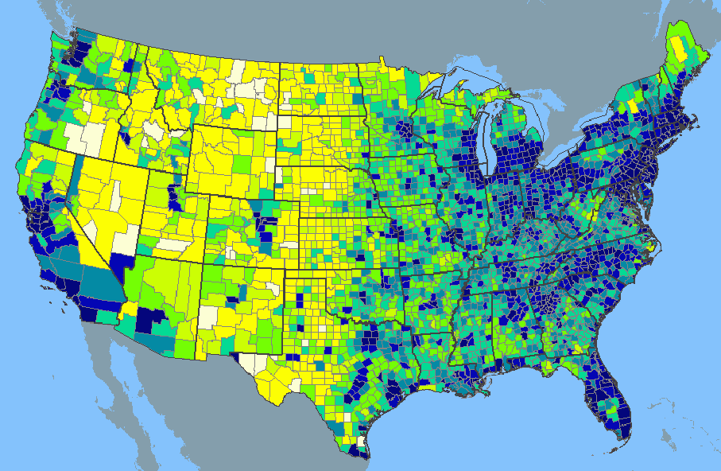
http://www.learnnc.org/lp/media/uploads/2010/02/usa-2000-population-density.gif

Slide 5
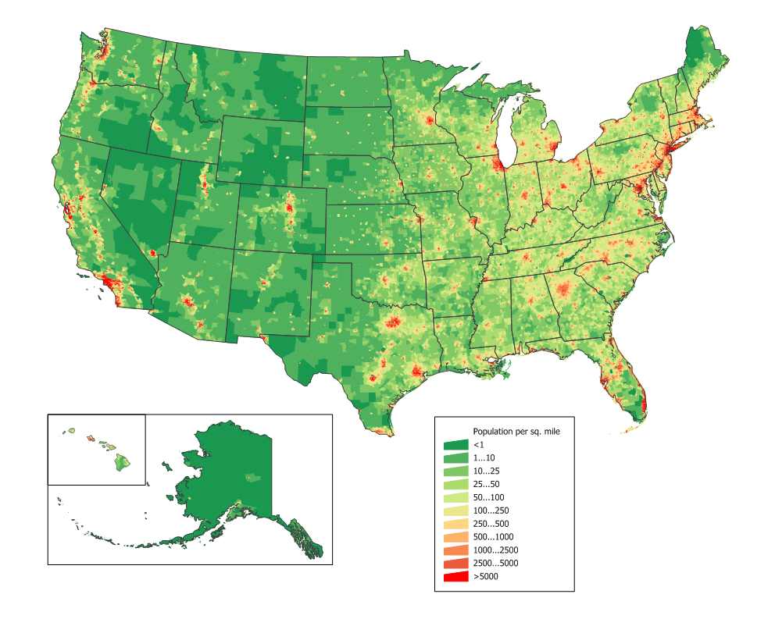
ZIP/Census track level and shown as ratio
http://upload.wikimedia.org/wikipedia/commons/2/21/US_population_map.png

Slide 6
Proportional Symbol

Slide 7
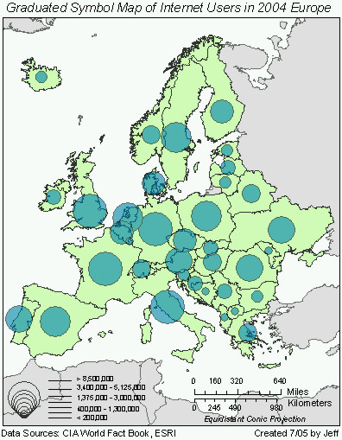
http://www.geog.ucsb.edu/~jeff/gis/proportional_symbols_files/map1.jpg

Slide 8
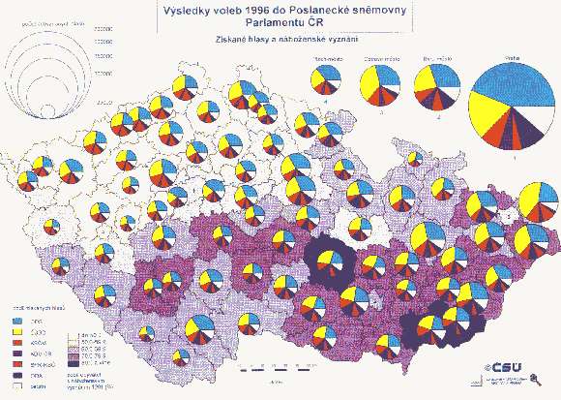
http://geographyfieldwork.com/DataPresentationMappingTechniques.htm

Slide 9
Isopleth

Slide 10
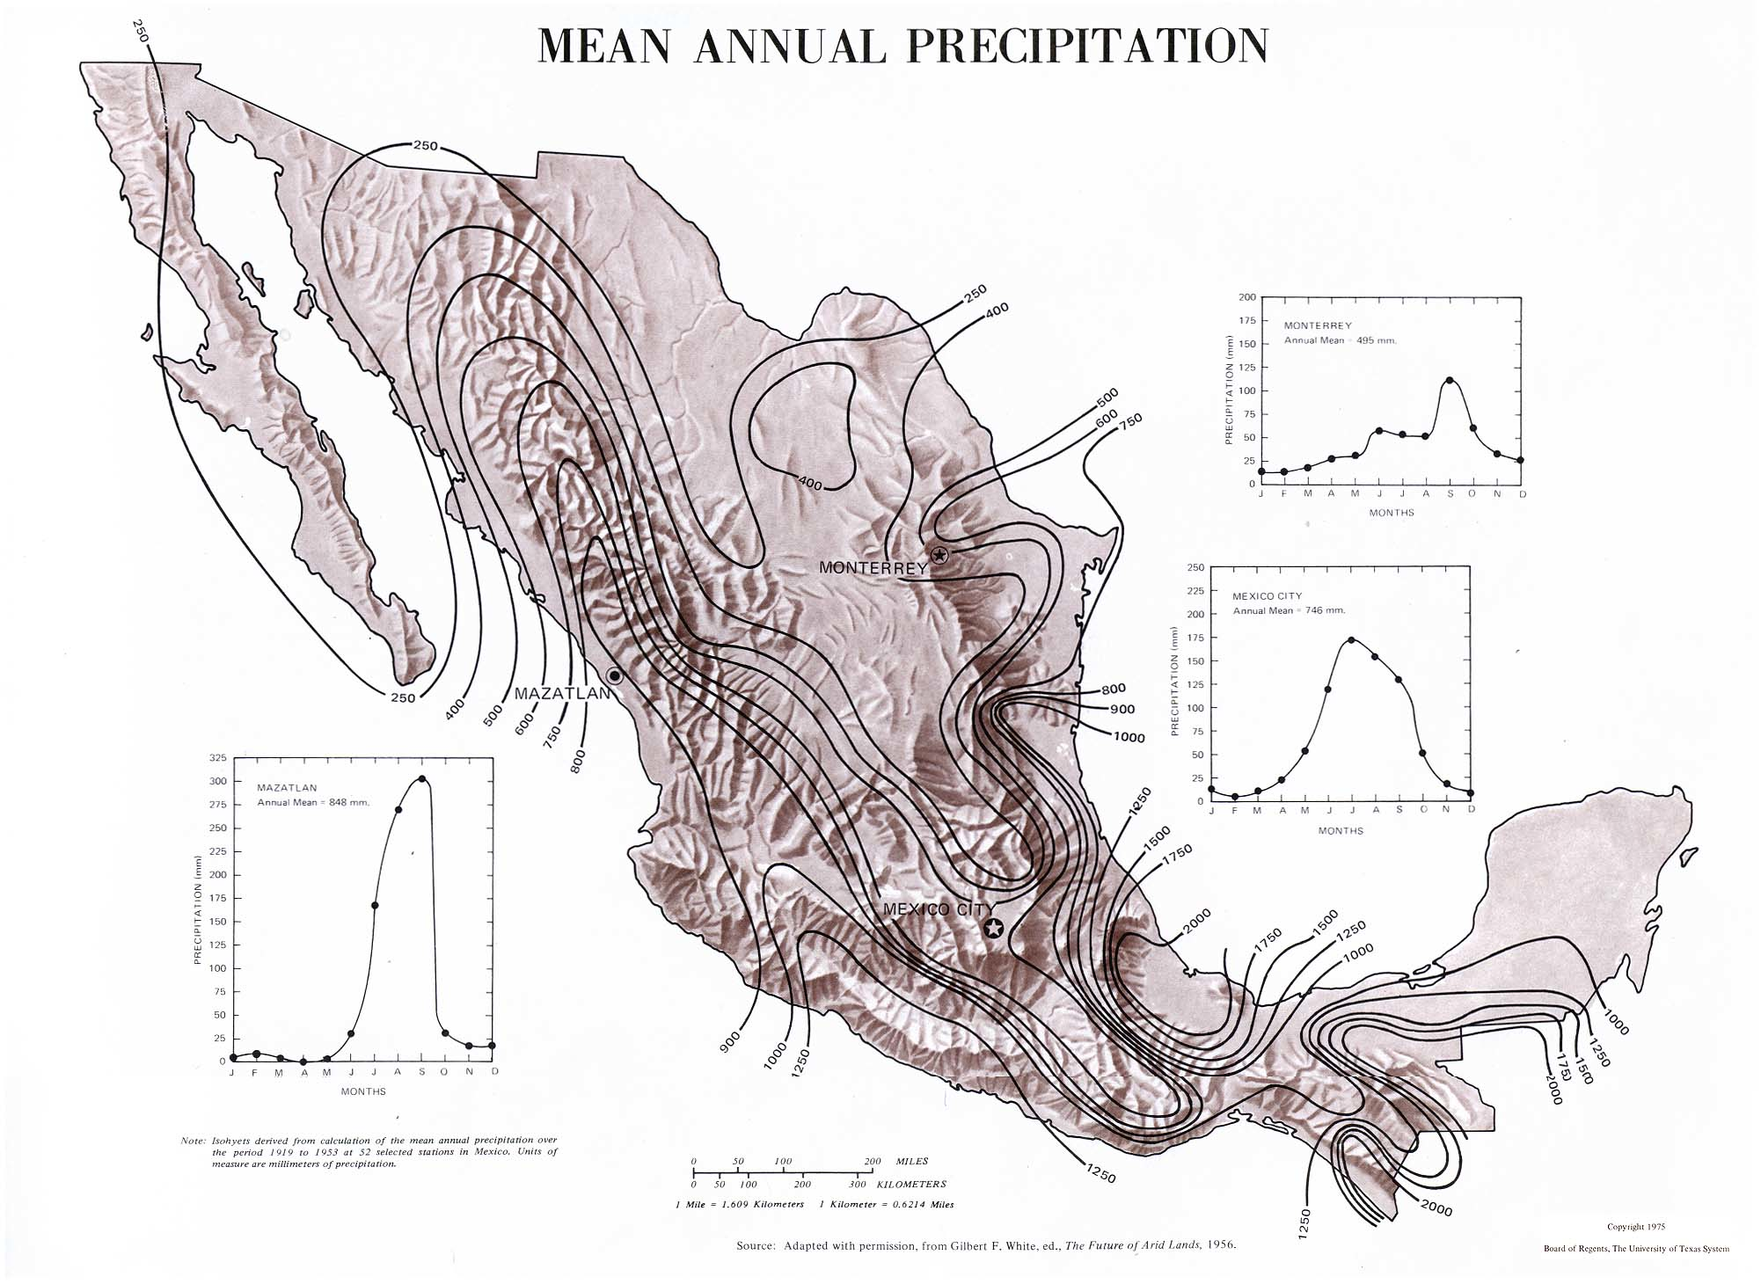
http://www.lib.utexas.edu/maps/atlas_mexico/mean_annual_precipitaion.jpg
Notes:
Two dimensional representation of 3 dimensional data, continuous lines not interrupted by artificial boundaries

Slide 11
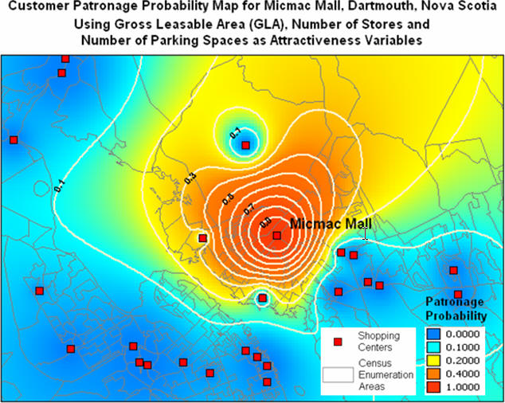
http://www.directionsmag.com/images/newsletter/2005/06_29/Figure2_lg.jpg

Slide 12
Dots

Slide 13
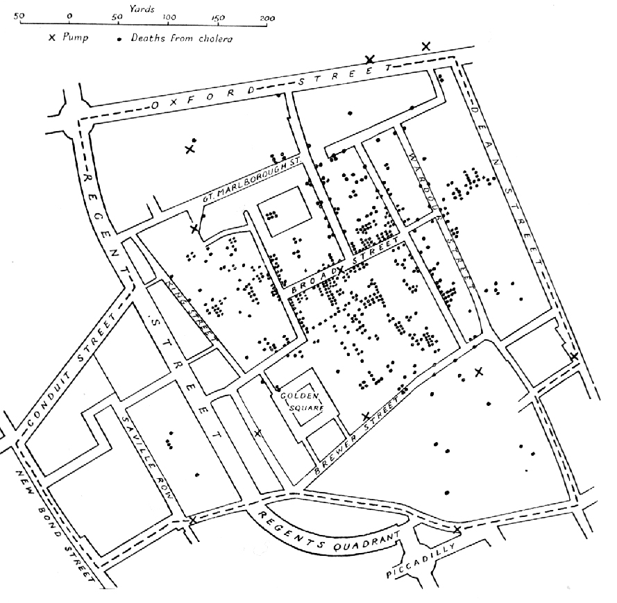

Slide 14
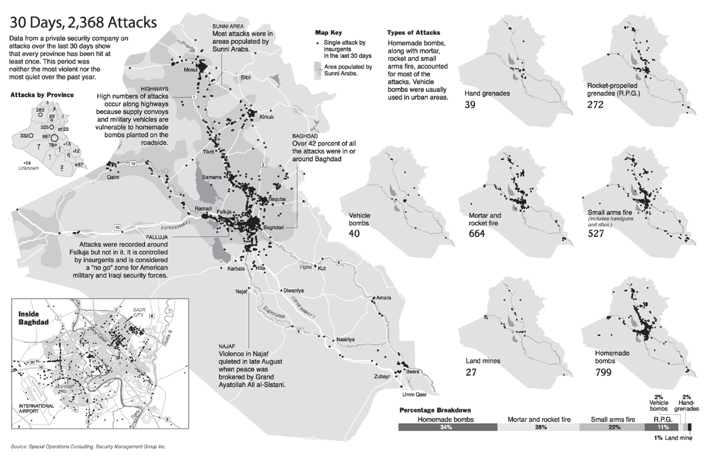

Slide 15
[Image Placeholder dots as symbols]

Slide 16
Generalized

Slide 17
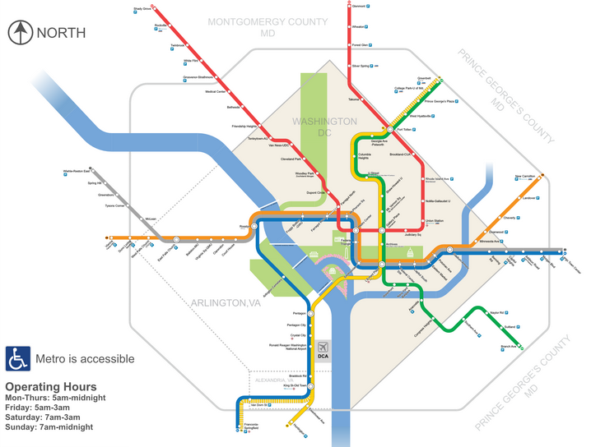
http://dctransitguide.com/static/images/WMATA_system_map.png

Slide 18
Cartogram

Slide 19
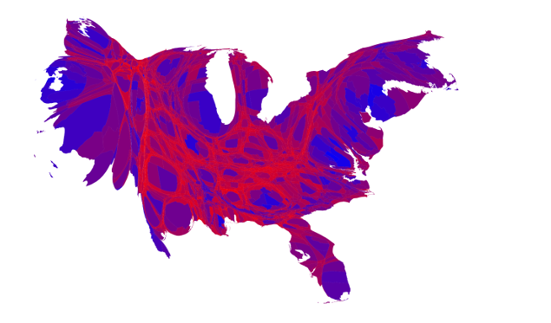
Source: http://www-personal.umich.edu/~mejn/election/2016/

Slide 20
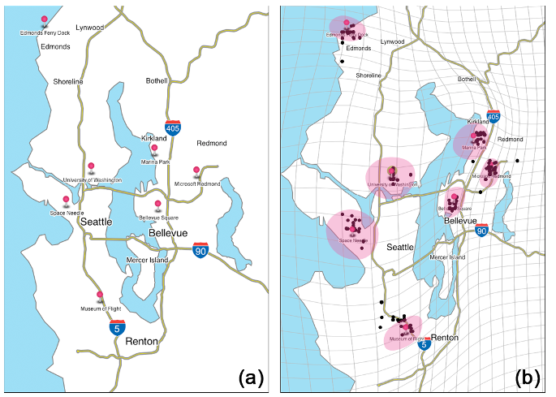
Hong et al., 2014. Traffigram: distortion for clarification via isochronal cartography

Slide 21
Other Types

Slide 22
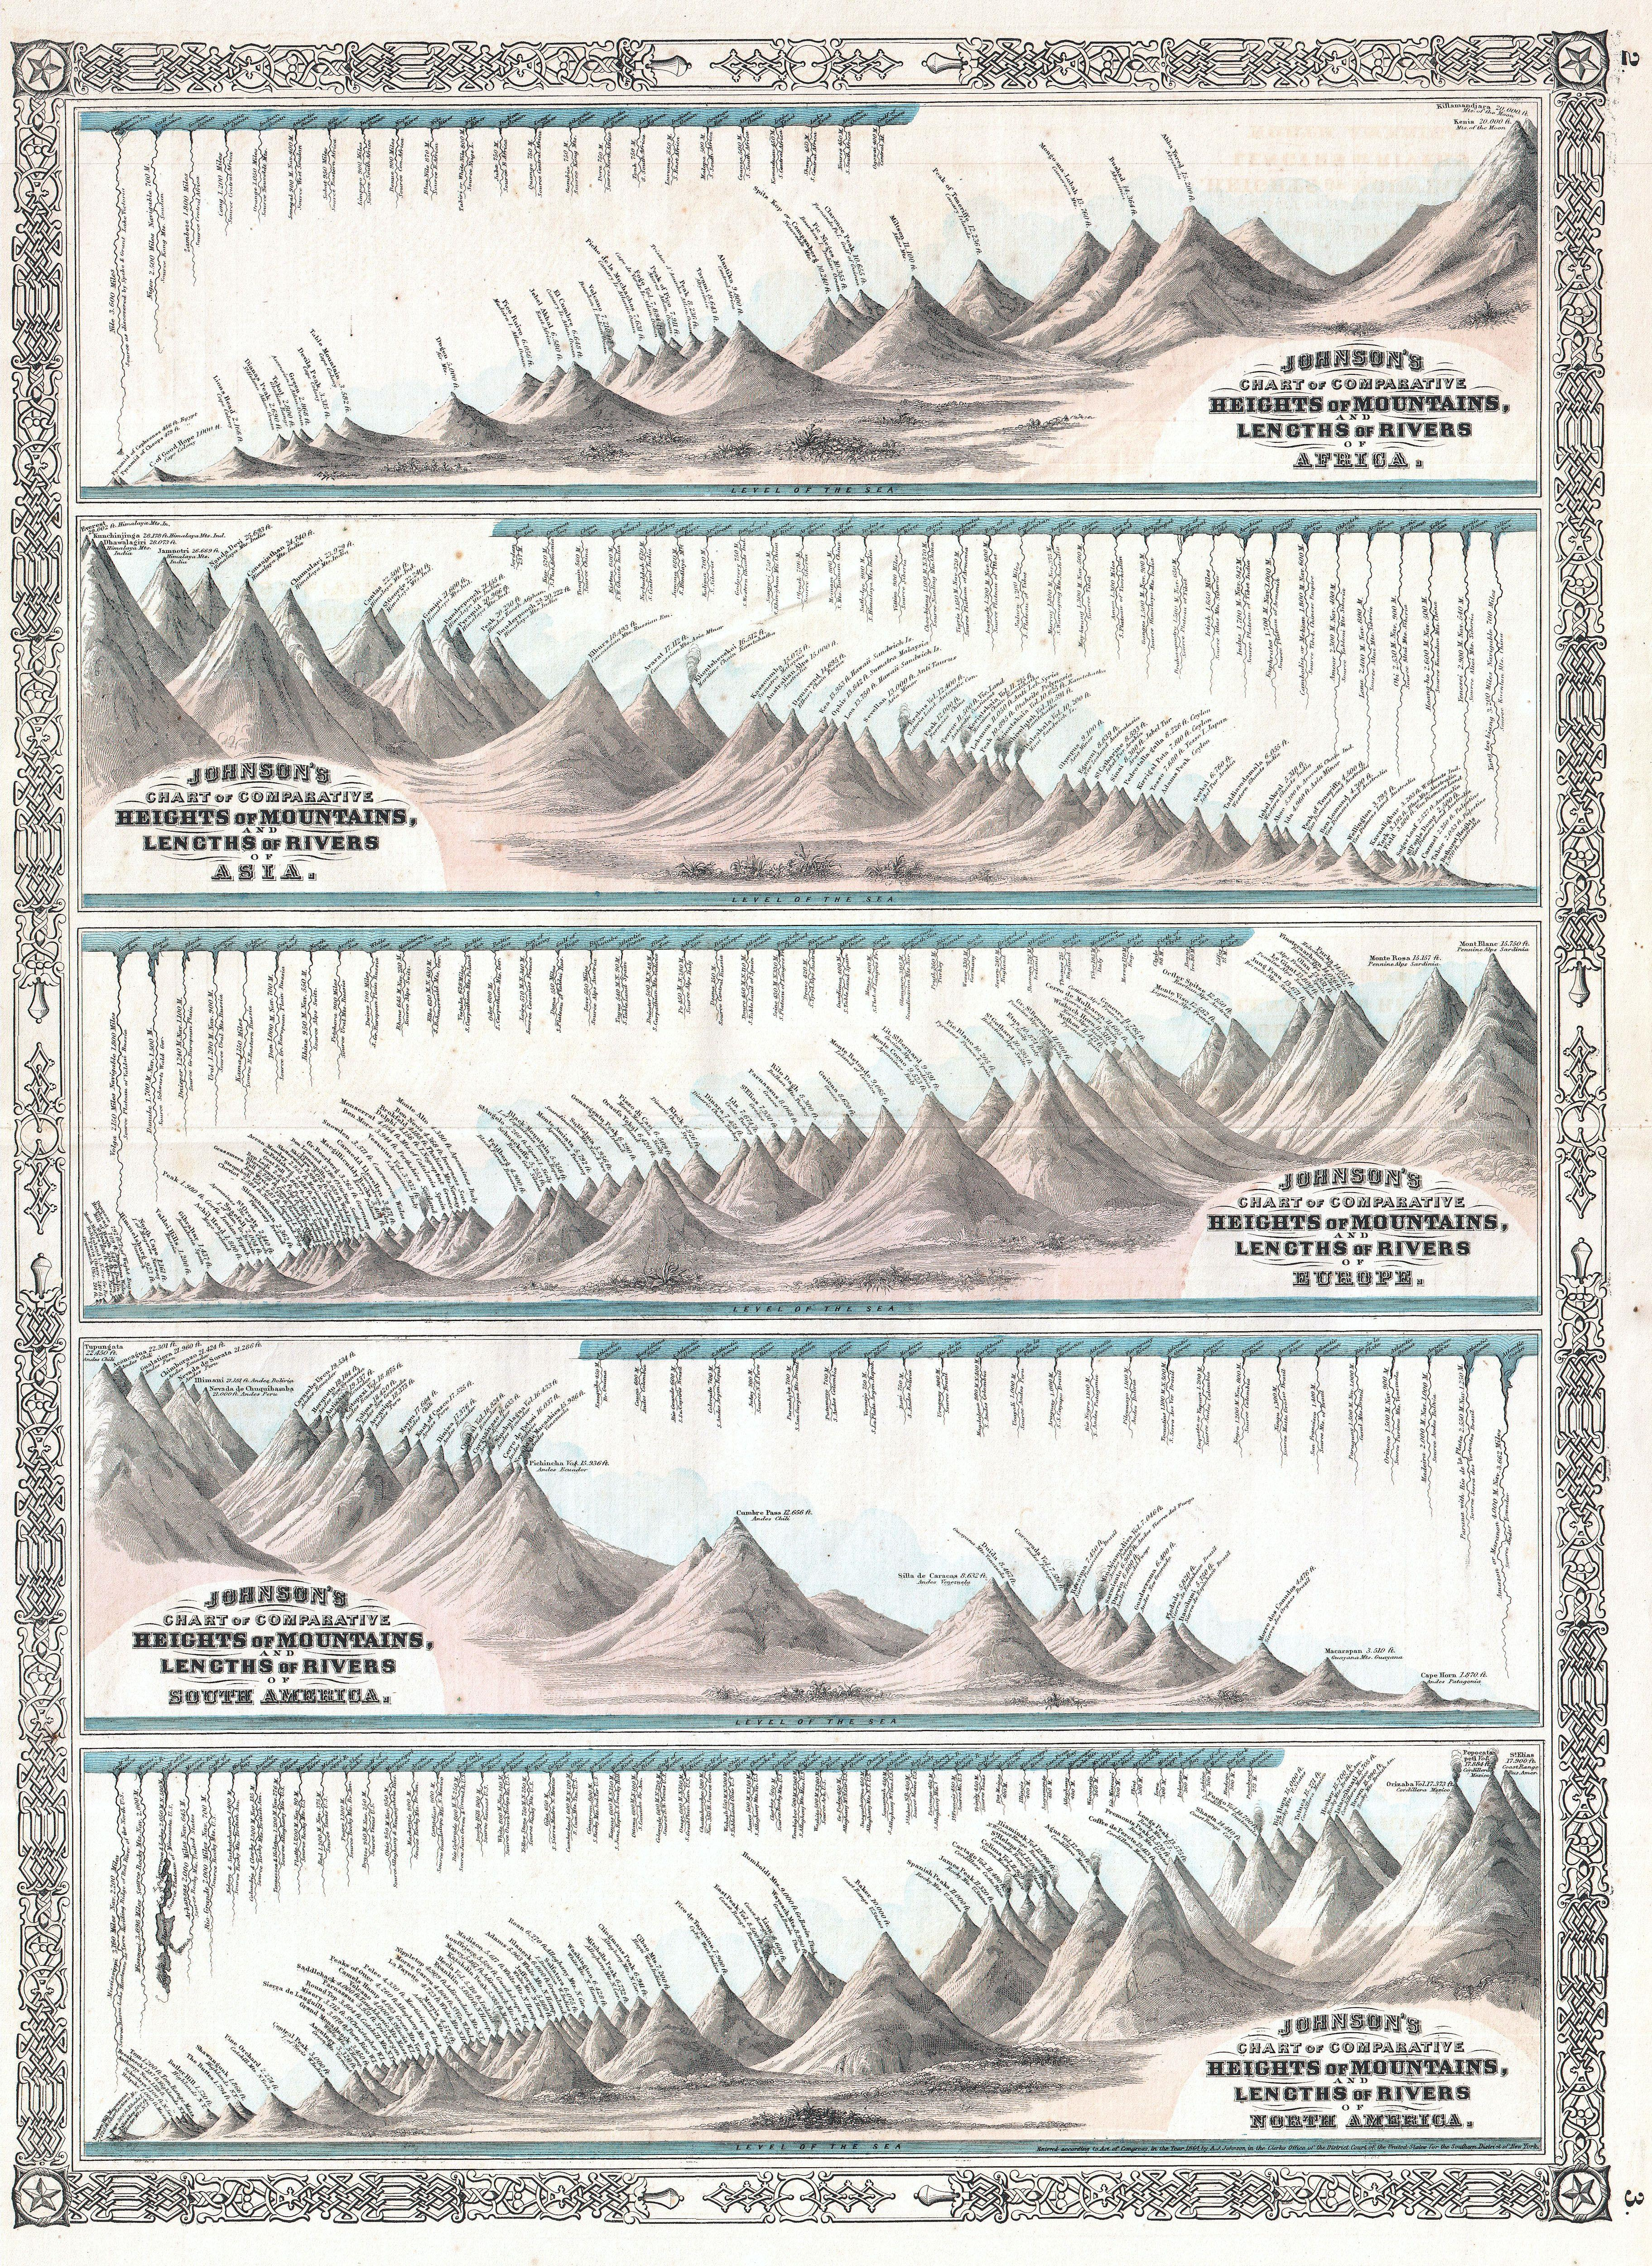

Slide 23
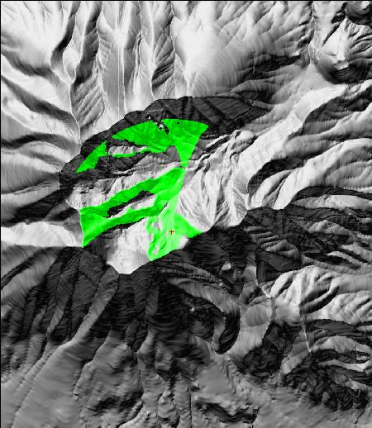

Slide 24
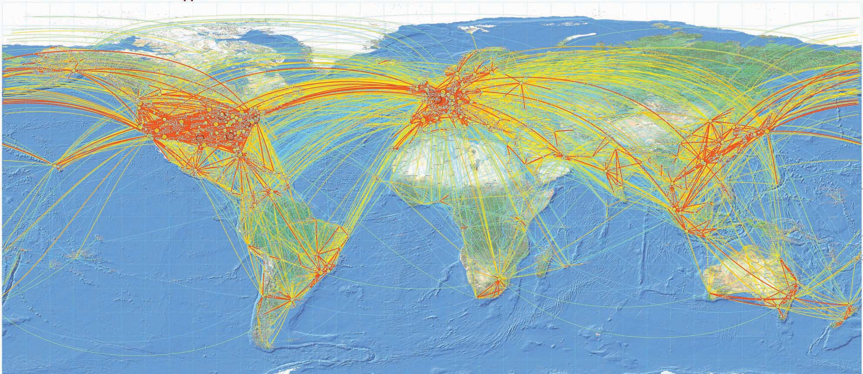
http://media.aerosociety.com/aerospace-insight/files/2012/01/World-traffic-flows-ICAO.jpg

Slide 25
Tools & Libraries

Slide 26
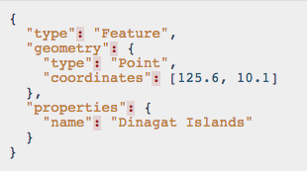
GeoJSON http://www.geojson.org

Slide 27
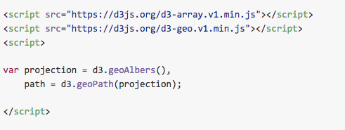
D3.geo https://github.com/d3/d3-geo

Slide 28
Tools & Libraries
Leaflet http://leafletjs.com/
MapBox https://www.mapbox.com/
PostGIS http://www.postgis.net/
Mapnik http://mapnik.org/

Slide 29


